Slide 1
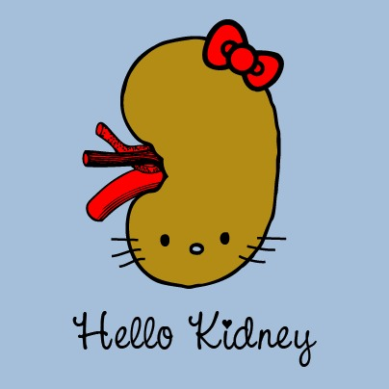
ACUTE NEPHRITIC SYNDROME

Slide 2
ACUTE
POST-STREPTOCOCCAL GLOMERULONEPHRITIS

Slide 3
Definition
AGN that follows an infection with a nephritogenic strain of group A beta hemolytic streptococci.
The classic example of the acute nephritic syndrome.
Nelson Textbook of Pediatrics, 7th Edition

Slide 4
Epidemiology
Most commonly – sporadic.
Despite that, epidemics and clusters of cases - in some poor or rural communities
Peak incidence - age 5-12 y/o.
Male : female ratio is 2 : 1.

Slide 5
Etiology and Pathogenesis
The child gets throat or skin infection by nephritogenic strain of group A beta hemolytic streptococci - serotype 12 , 4 and 1
Antibodies to streptoccocus (eg antistreptolysin O) are formed in his circulation
Antigen-antibody circulating immune complexes are subsequently deposited along the glomerular basement membrane (GBM).

Slide 6
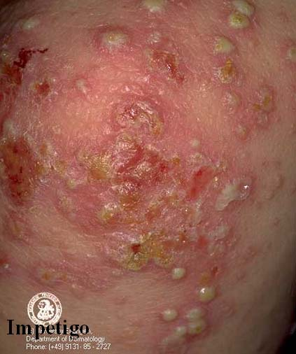
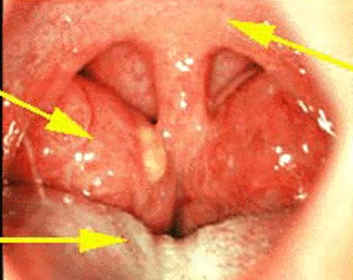
Clinical Features

Slide 7
Typical Manifestation
Develop acute nephritic syndrome 1–2 wk after an antecedent streptococcal pharyngitis or 3–6 wk after a streptococcal pyoderma.
Edema
Face, periorbital area → lower extremities → generalized (ascites, pleural effusions)
2. Proteinuria :
3. Oliguria

Slide 8
Typical Manifestation (2)
Gross hematuria
Smoky, tea-colored, cola-colored, or fresh bloody urine
Hypertension (50%) – mild to moderate, typically subsides promptly after diuresis
Nonspecific symptoms:
Such as anorexia, vomiting, general malaise, lethargy, abdominal or flank pain, low-grade fever and weight gain.

Slide 9
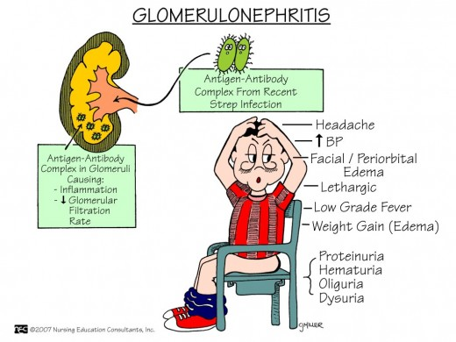

Slide 10
Complications in severe cases
Circulatory hypervolemia / Congestive heart failure
Encephalopathy
Acute renal failure

Slide 11
Laboratory Investigations
Urinalysis
Bacteriological and Serological test
Renal function test
Full blood count
Serum complement levels
Kidney ultrasound

Slide 12

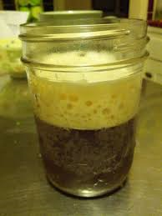
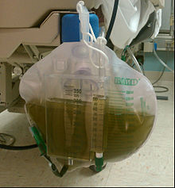
Laboratory Investigations
Urinalysis
  Macroscopic hematuria: Rusty or tea-color.
  Proteinuria 2+.
  RBCs casts.
  Pyuria.

Slide 13
Laboratory Investigations
Evidences of streptococcal infection
  Throat or skin cultures.
  Antistreptolysin O (ASO) titer: rising titre .
  Anti-deoxyribonuclease (DNase) B level.
Renal function Test: May be elevated
  Hyperkalemia, hypocalcaemia, hyponatremia, and metabolic
  acidosis are seen only in severe patients.
  C3: decreased

Slide 14
Diagnosis
Acute onset
Symptoms: edema, oliguria, dark urine, hypertension
Urinalysis: RBCs, protein, casts
Evidences of streptococcal infection:
  Prodromes
  Elavated serum titers of Abs to streptozymes(ASO)
Serum C3 - Reduced

Slide 15
Treatment of APSGN is largely that of supportive care.
Usually, patients undergo a spontaneous diuresis within 7 to 10 days after the onset of their illness - strict monitoring – nephrotic chart + fluid restriction until diuresis
Management is directed at treating the acute effects of renal insufficiency and hypertension

Slide 16
Treatment
Diuretics
Diet
Fluid restriction – during oliguric phase
Sodium restriction is necessary: hypertension, heart faliure
Protein restriction is unnecessary except if raised cheimstry.
Antibiotics
A 10-day course of systemic antibiotic therapy with penicillin is recommended to limit the spread of the nephritogenic organisms.
Antibiotic therapy does not affect the natural history of glomerulonephritis.
Paediatric Protocols, 12th Edition

Slide 17
Treatment for complications
Bed rest
Recheck BP ½ hour later
Oral nifedipine
Add
Furosemide
Other oral AHT
Significant asymptomatic hypertension
Look for signs and symptoms
Reduce BP by 25% of target BP over 3-12 hrs
Emergency management indicated
Target BP control
Next reduction of 75% over 48 hrs
symptomatic, severe hypertension or hypertensive emergency / encephalopathy
Paediatric Protocols, 12th Edition

Slide 18
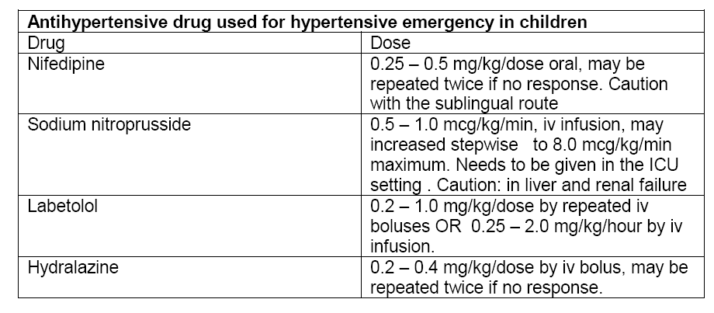
Paediatric Protocols, 12th Edition

Slide 19
Treatment for complications
Acute pulmonary edema
-Give O2
-prop patient up
-ventilatory support if necessary
IV
furosemide
Fluid restriction
-withhold fluid for 24 Hrs if possible
Consider dialysis if no response to diuretics
Paediatric Protocols, 12th Edition

Slide 20
Treatment for complications
Acute Renal Failure
Monitor BP & managing hypertension
Limiting fluid intake in oliguric state
Correcting electrolyte imbalance ie life threatening hyperkalemia
Optimizing nutritional intake (since ARF pt usually hypercatabolic)
Implementing acute dialysis
Paediatric Protocols, 12th Edition

Slide 21
Nephrotic Syndrome

Slide 22
Definition
Manifestation of glomerular disease, characterized by nephrotic range proteinuria and a triad of clinical findings associated with large urinary losses of protein ,hypoalbuminaemia , edema and hyperlipidemia
  Protein excretion of > 40 mg/m²/hr
  First morning protein : creatinine ratio of > 2-3 : 1

Slide 23
Incidence
2 – 7 cases per 100,000 children per year
Higher in underdeveloped countries ( South east Asia )
Occurs at all ages but is most prevalent in children between the ages 1.5-6 years.
It affects more boys than girls, 2:1 ratio

Slide 24
Etiology
Genetic
Secondary
Idiopathic or Primary

Slide 25
Pathophysiology
Complex disturbances in
immune system
Genetic Mutations /
Mutations in proteins
Extensive effacement of podocyte foot processes
Increased permeability of the glomerular capillary wall
Massive proteinuria
Hypoalbuminaemia
Edema

Slide 26
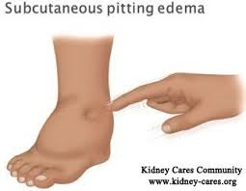
Clinical Features
Edema
  Mild and start with peri orbital puffiness, lower extremities, then progress to generalized edema, ascites, pleural effusion, genital edema
Decreased urine output
Anorexia, Irritability, Abdominal pain and diarrhoea
Absence of
  Hypertension
  Gross hematuria

Slide 27
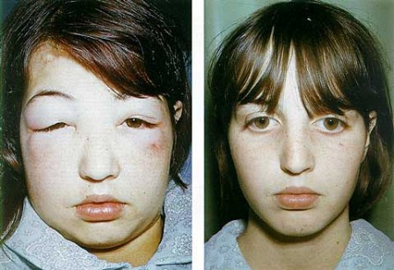
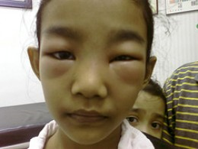

Slide 28
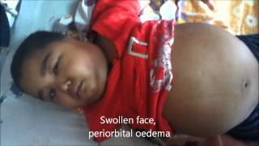

Slide 29
DIFFERENTIALS
Protein losing enteropathy
Hepatic failure
Heart failure
Acute/Chronic Glomerulonephritis
Protein Malnutrition

Slide 30
Lab Investigations
Urine Examination
Complete Blood Count & Blood picture
Renal parameters :
  Spot Urine Protein : Creatinine ratio
  Urinary protein excretion
Liver Function Test
Renal Biopsy ???

Slide 31
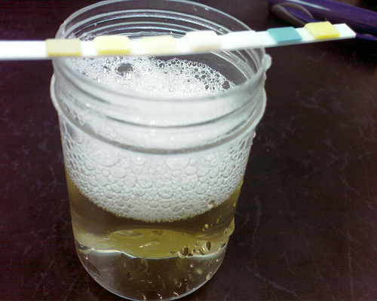
  Urinalysis - 3+ to 4+ proteinuria
  Renal Function
  Spot UPC ratio > 2.0
  UPE > 40 mg/m²/hr
Serum Creatinine – normal or elevated
Serum albumin - < 2.5 gm/dl
Serum Cholesterol/ TGA levels – elevated

Slide 32
Initial Episode
Management
High protein diet
Salt moderation
Treatment of infections
If significant edema :- diuretics & Aldosterone antagonist ( Fursemide, spironolactone )
Corticosteroid therapy with Prednisolone or prednisone
  ( 2mg/kg per day for 6 weeks followed by 1.5 mg/kg single morning dose on alternate days for 6 weeks )

Slide 33
DEFINITION FOR IDIOPATHIC NS
REMISSION:
Urinary protein excretion < 4 mg/m²/hour or urine dipstick nil/trace for 3 consecutive days.
RELAPSE:
Urinary protein excretion > 40 mg/m²/hour or urine dipstick ++ or more for 3 consecutive days.

Slide 34
Management of SRNS
Steroids + calcineurin inhibitors + ACE inhibitors + Diuretics

Slide 35
The metabolism and excretion of many drugs and their pharmacologically active metabolites depend on normal renal function.
Accumulation and toxicity can develop rapidly if dosages are not adjusted in patients with impaired renal function.
A familiarity with basic pharmacologic principles and a systematic approach are necessary when adjusting drug dosages in patients with abnormal kidney function.

Slide 36
The distinct steps involve :
calculating the patient's glomerular filtration rate
Choosing and administering a loading dose
Determining a maintenance dose
Decision regarding monitoring of drug concentrations.
If done properly, therapy in renal patients should achieve the desired pharmacologic effects while avoiding drug toxicity.

Slide 37
An awareness of biologically active or toxic metabolites of parent compounds that accumulate when the glomerular filtration rate is reduced is also necessary to avoid toxicity.
The effects of dialysis on drug elimination and the need for supplemental dosing are additional considerations in patients undergoing renal replacement therapy.

Slide 38


